Slide 1
Black History Month
Black History Month 2026
Black History Month (BHM) is celebrated in different countries around the world. In the UK, it is held in October and is a time to recognise the achievements and contributions of Black people across society.
What figures do you know who’ve played an important part in Black history?
How many figures on the next slide can you recognise?

Slide 2
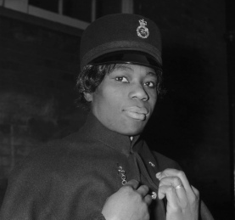
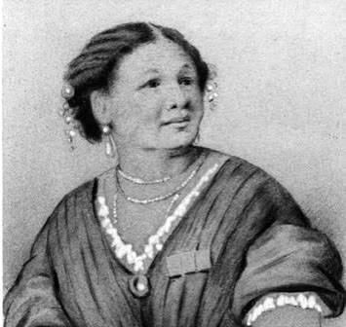
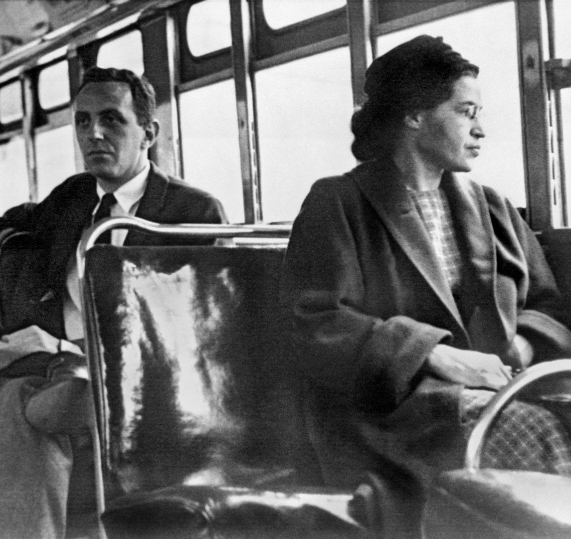
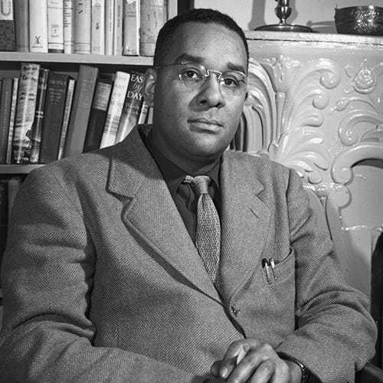
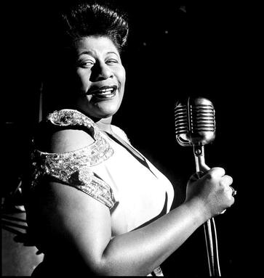
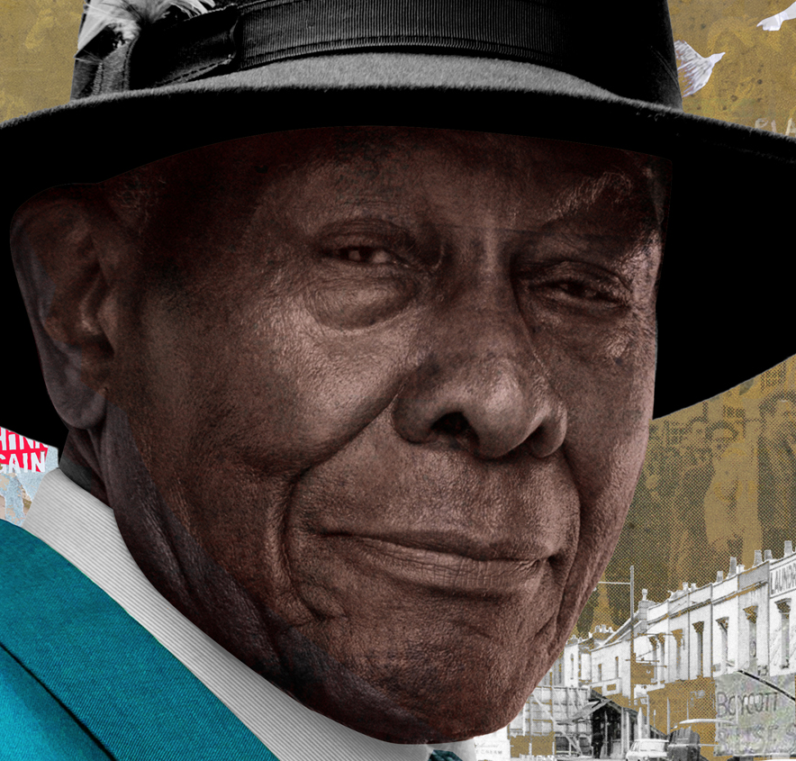
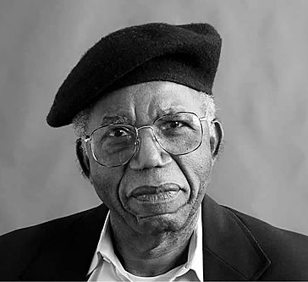
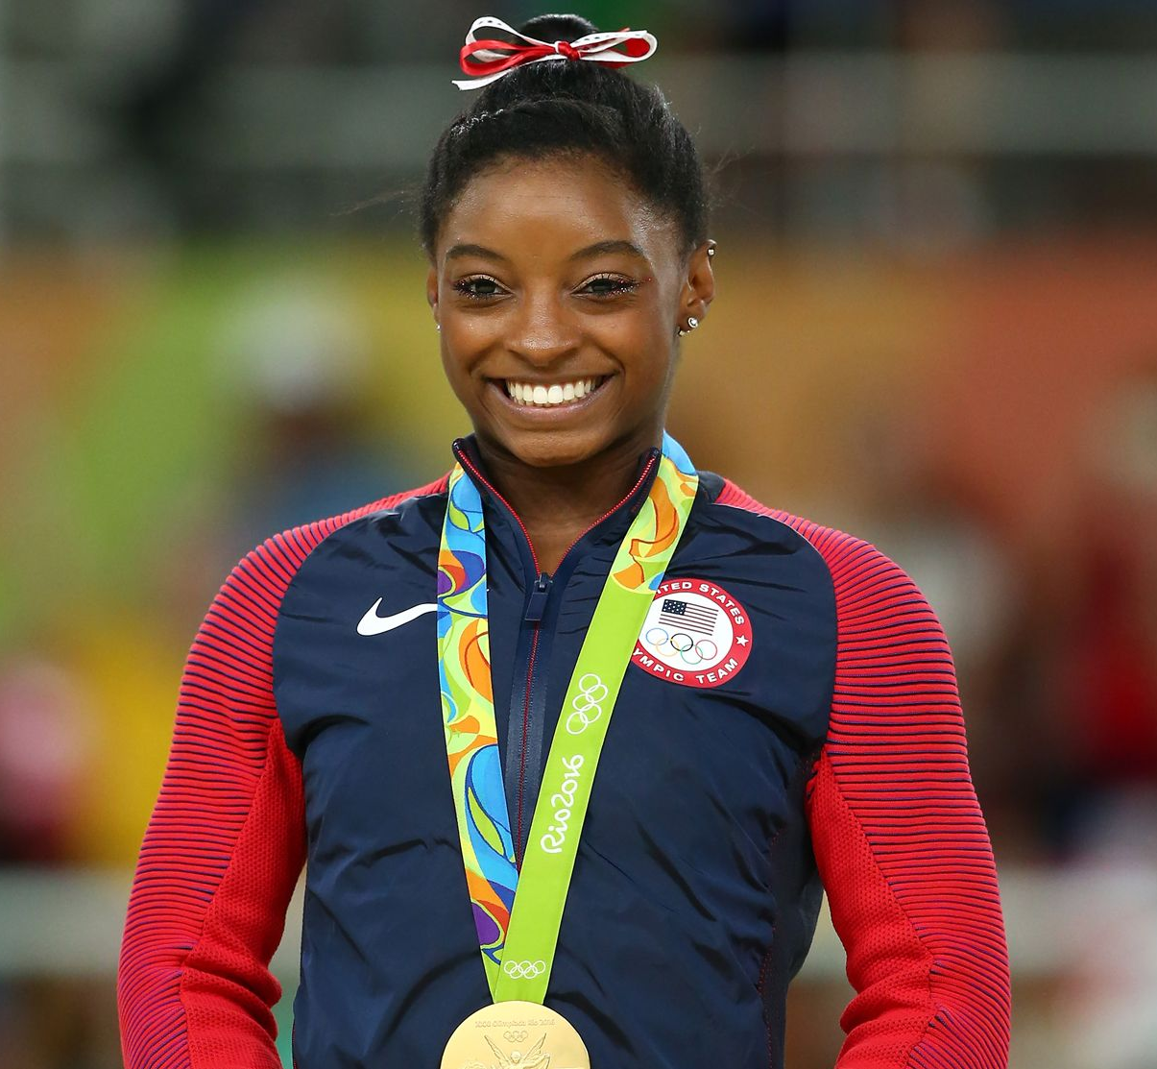
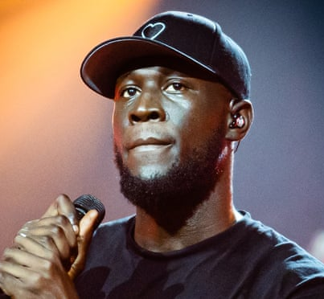
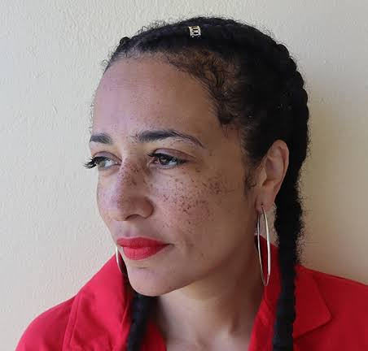
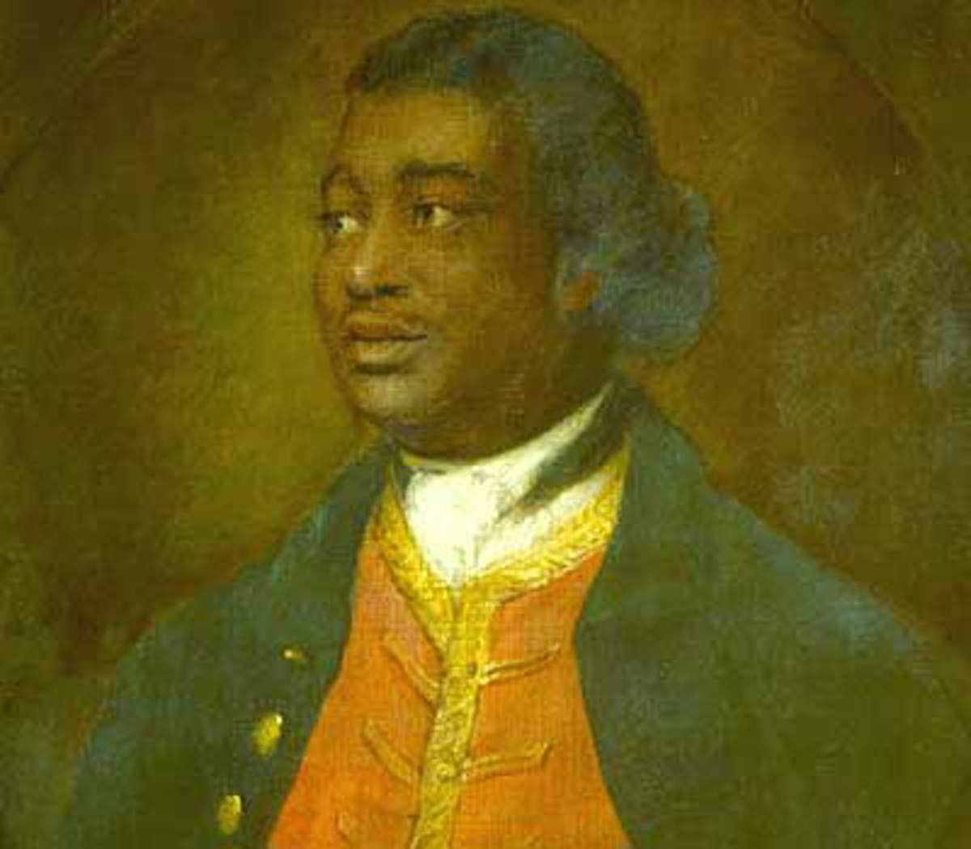
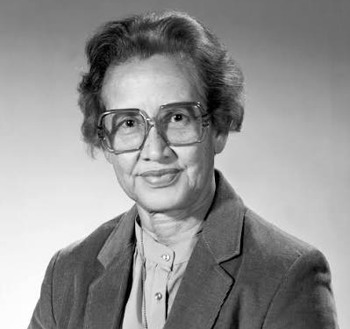
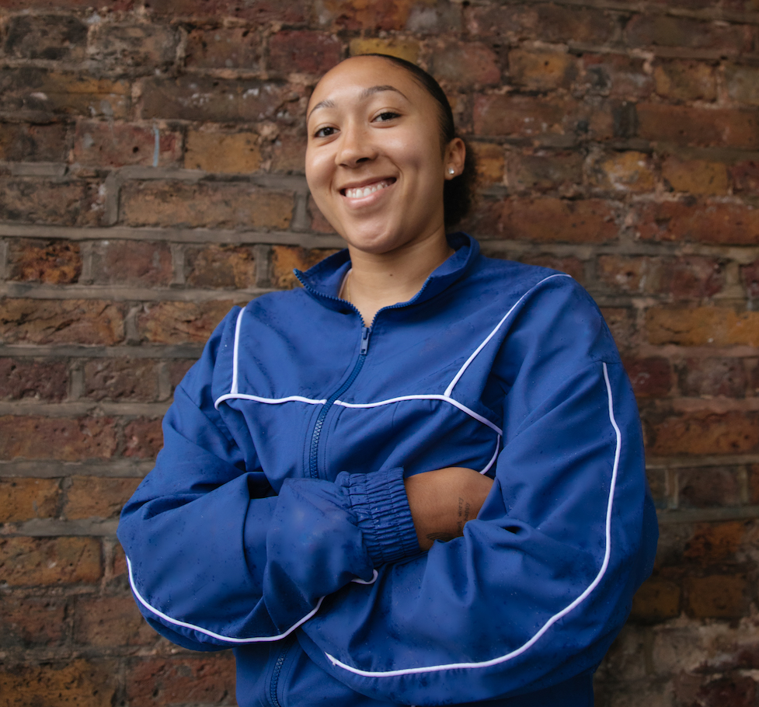
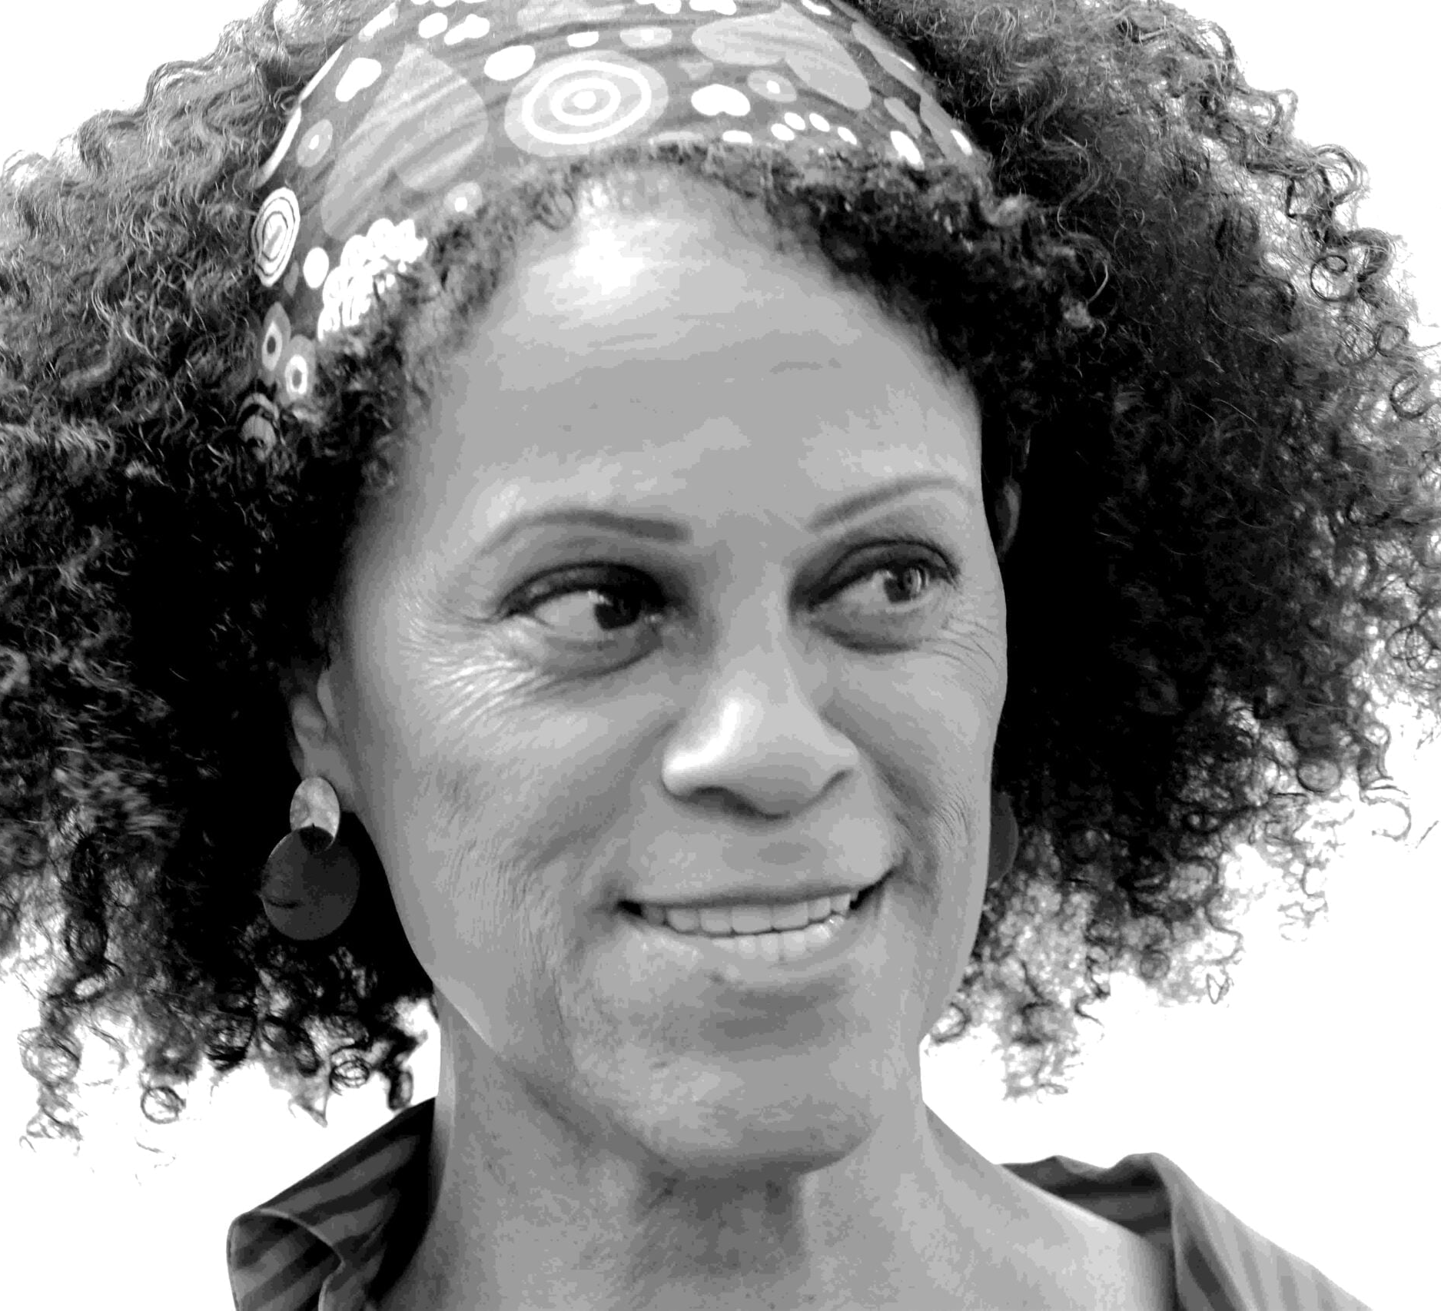
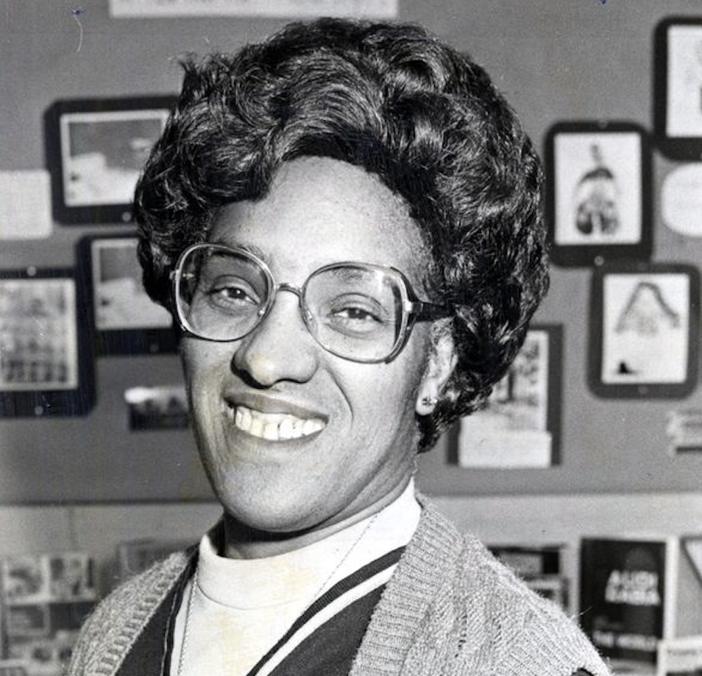
A | B | C | D | E
F | G | H | I | J
K | L | M | N | O
Notes:
A = Sislin Fay Allen (first Black female police officer)
B = Mary Seacole (businesswoman and nurse during the Crimean War)
C = Rosa Parks (refused to give up her bus seat in Montgomery in 1955)
D = Richard Wright (author who wrote about racism and poverty)
E = Ella Fitzgerald (widely celebrated jazz singer)
F = Roy Hackett (civil rights campaigner and community leader)
G = Chinua Achebe (widely celebrated Nigerian author)
H = Simone Biles (most decorated gymnast in history)
I = Stormzy (musician and philanthropist)
J = Zadie Smith (British author and academic)
K = Ignatius Sancho (writer, composer and abolitionist)
L = Katherine Johnson (NASA mathematician whose work was vital to the Mercury and Apollo missions)
M = Lauren James (Chelsea and England footballer who won the 2025 Euros)
N = Bernardine Evaristo (author and the first black woman to win the Booker Prize)
O = Betty Campbell (Wales’s first black headteacher)

Slide 3
A | B | C | D | E
F | G | H | I | J
K | L | M | N | O
Notes:
A = Sislin Fay Allen (first Black female police officer)
B = Mary Seacole (businesswoman and nurse during the Crimean War)
C = Rosa Parks (refused to give up her bus seat in Montgomery in 1955)
D = Richard Wright (author who wrote about racism and poverty)
E = Ella Fitzgerald (widely celebrated jazz singer)
F = Roy Hackett (civil rights campaigner and community leader)
G = Chinua Achebe (widely celebrated Nigerian author)
H = Simone Biles (most decorated gymnast in history)
I = Stormzy (musician and philanthropist)
J = Zadie Smith (British author and academic)
K = Ignatius Sancho (writer, composer and abolitionist)
L = Katherine Johnson (NASA mathematician whose work was vital to the Mercury and Apollo missions)
M = Lauren James (Chelsea and England footballer who won the 2025 Euros)
N = Bernardine Evaristo (author and the first black woman to win the Booker Prize)
O = Betty Campbell (Wales’s first black headteacher)

Slide 4
Black History Month
Black History Month 2026 – Video
Ignatius Sancho (K) The first known Black man to vote in Britain
Mary Seacole (B) Ran the British Hotel near the Crimean War front
Roy Hackett (F) Leader of the 1963 Bus Boycott
Sislin Fay Allen (A) First Black female police officer in 1968
Stormzy (I) Funds scholarships for Black students at Cambridge
Black history is British history, covering both resistance to injustice and celebration of achievement

