Slide 1
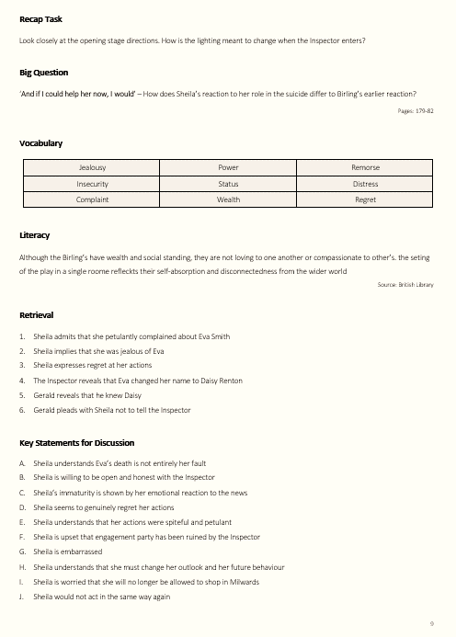
Recap Task
Links to the previous lesson or lessons. A task for students to work on when they enter the room. Something that could lead to further analysis and debate etc.
Big Question
Each ‘big question’ is anchored to a short quotation to signal the starting point for the discussions that should follow the reading. The page numbers at the bottom are taken from the Penguin edition of ‘An Inspector Calls and Other Plays’ (the one with the dark, blurry front cover).
Vocabulary
Words to shape discussions and extended writing.
Literacy
All students need to do is highlight and correct the errors.
Retrieval Statements
Useful as a basic reminder of what happens in each section of the play. Students could retrieve supporting quotations or identify page numbers.
‘Key’ Stuff.
The key statements/images/quotations/notes (etc.) at the bottom of each page always link to the ‘big questions’ and form the basis of whatever you choose to do – a bit of writing, some notetaking, questioning, speaking and listening…

