Slide 1
What subjects are depicted?
What aspects of each painting are emphasised?
What colours are used?
What contrasts can you see?
What emotions are conveyed?
What three words best describe each painting?

Slide 2
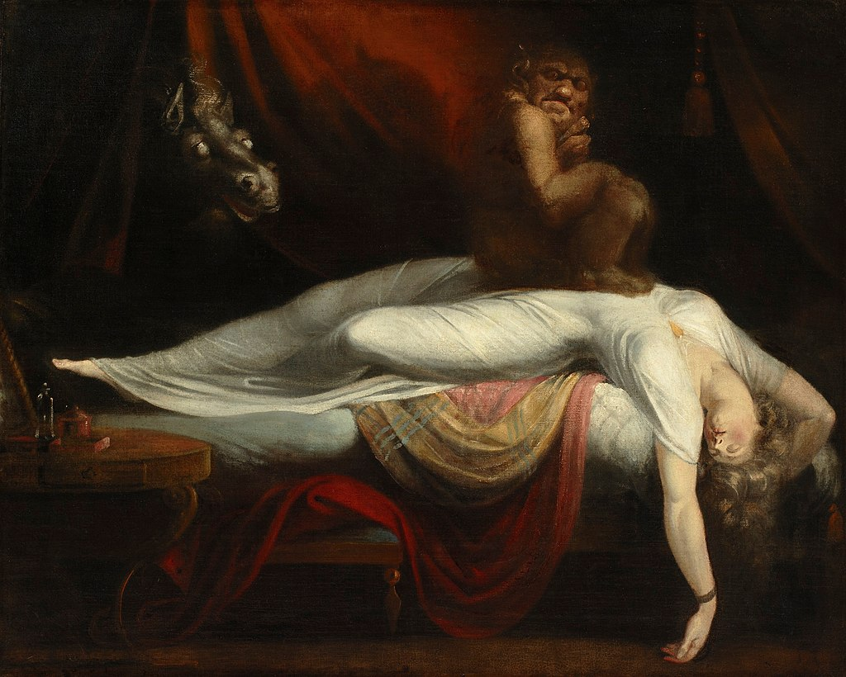
The Nightmare
Henry Fuseli
1781

Slide 3
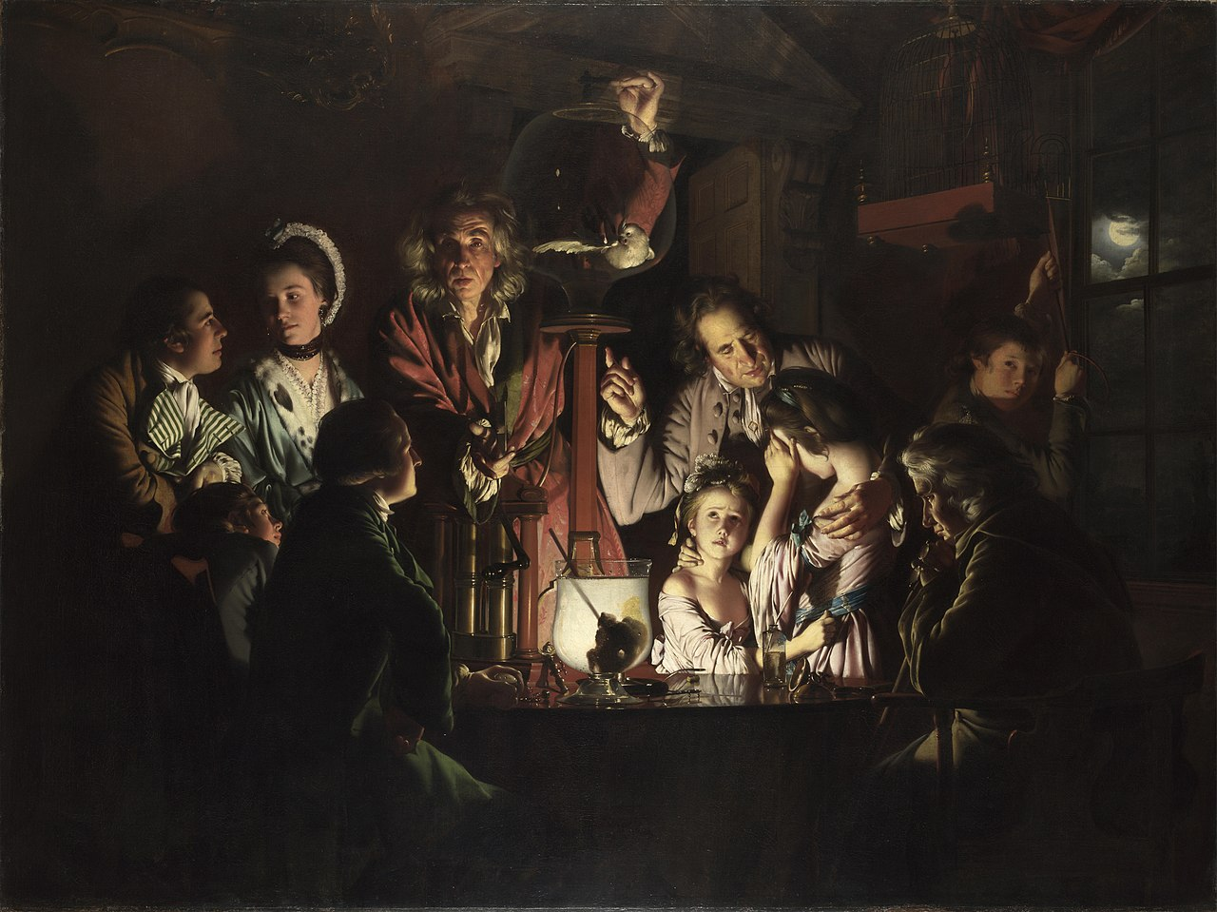
An Experiment on a Bird in the Air Pump
Joseph Wright of Derby
1786

Slide 4
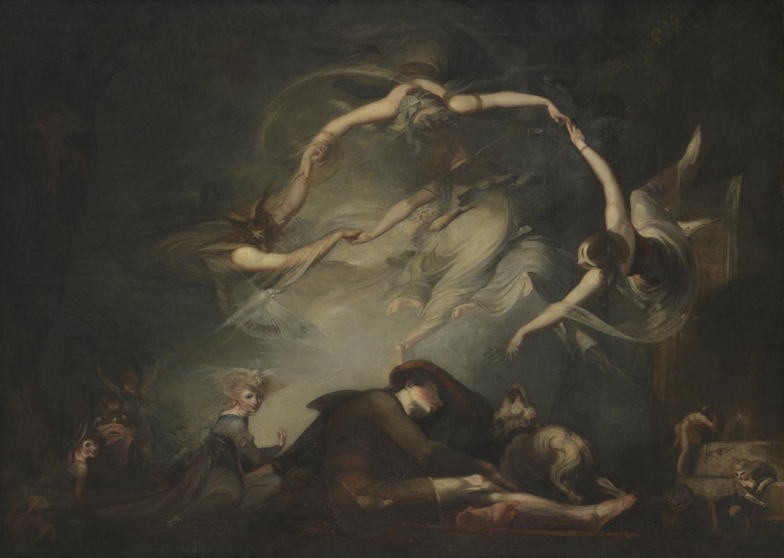
The Shepherd’s Dream
Henry Fuseli
1793

Slide 5
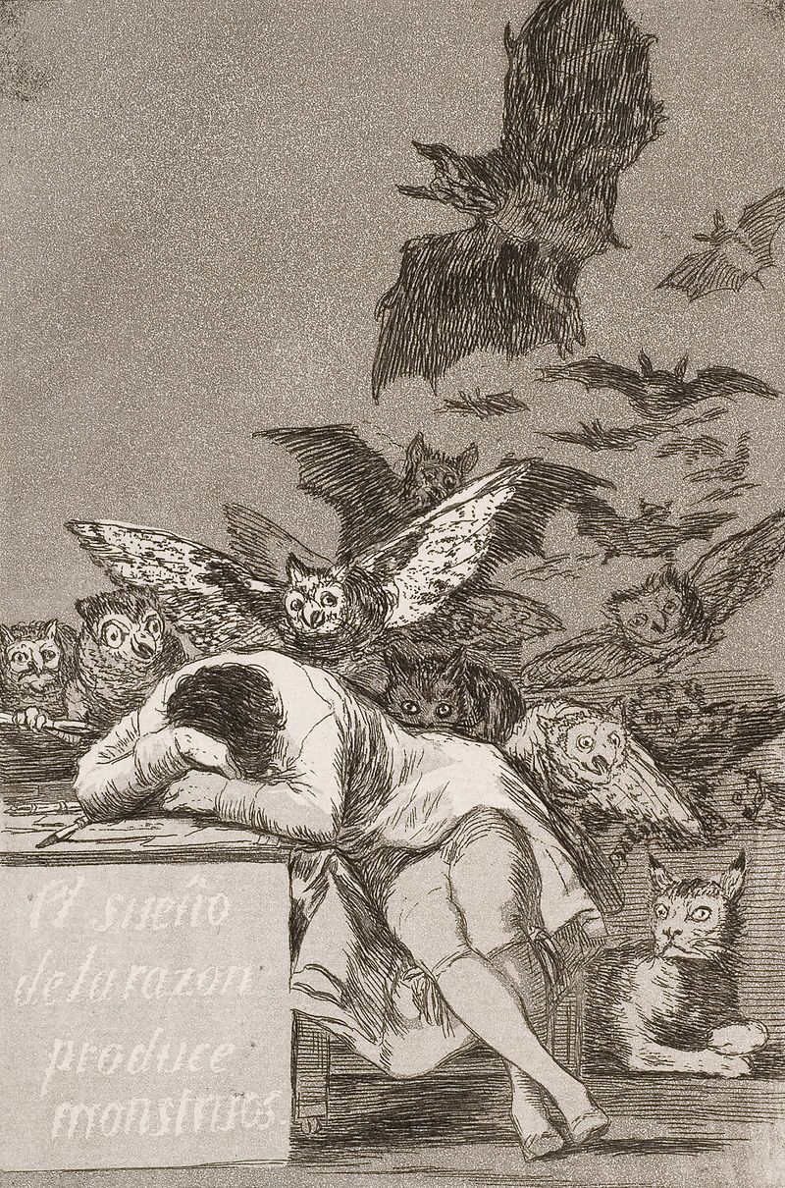
The Sleep of Reason Produces Monsters
Francisco Goya
1797

Slide 6
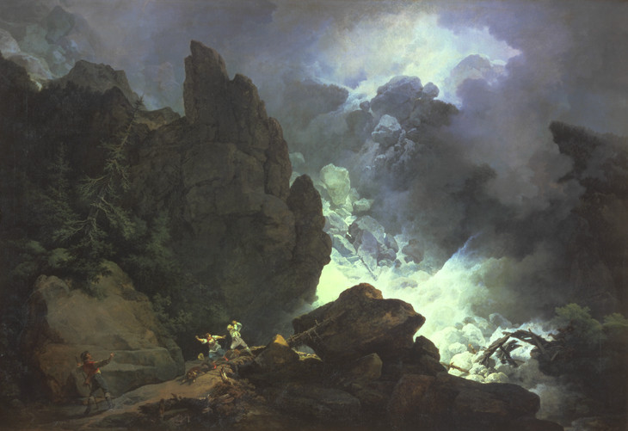
An Avalanche in the Alps
Philip James De Loutherbourg
1803

Slide 7
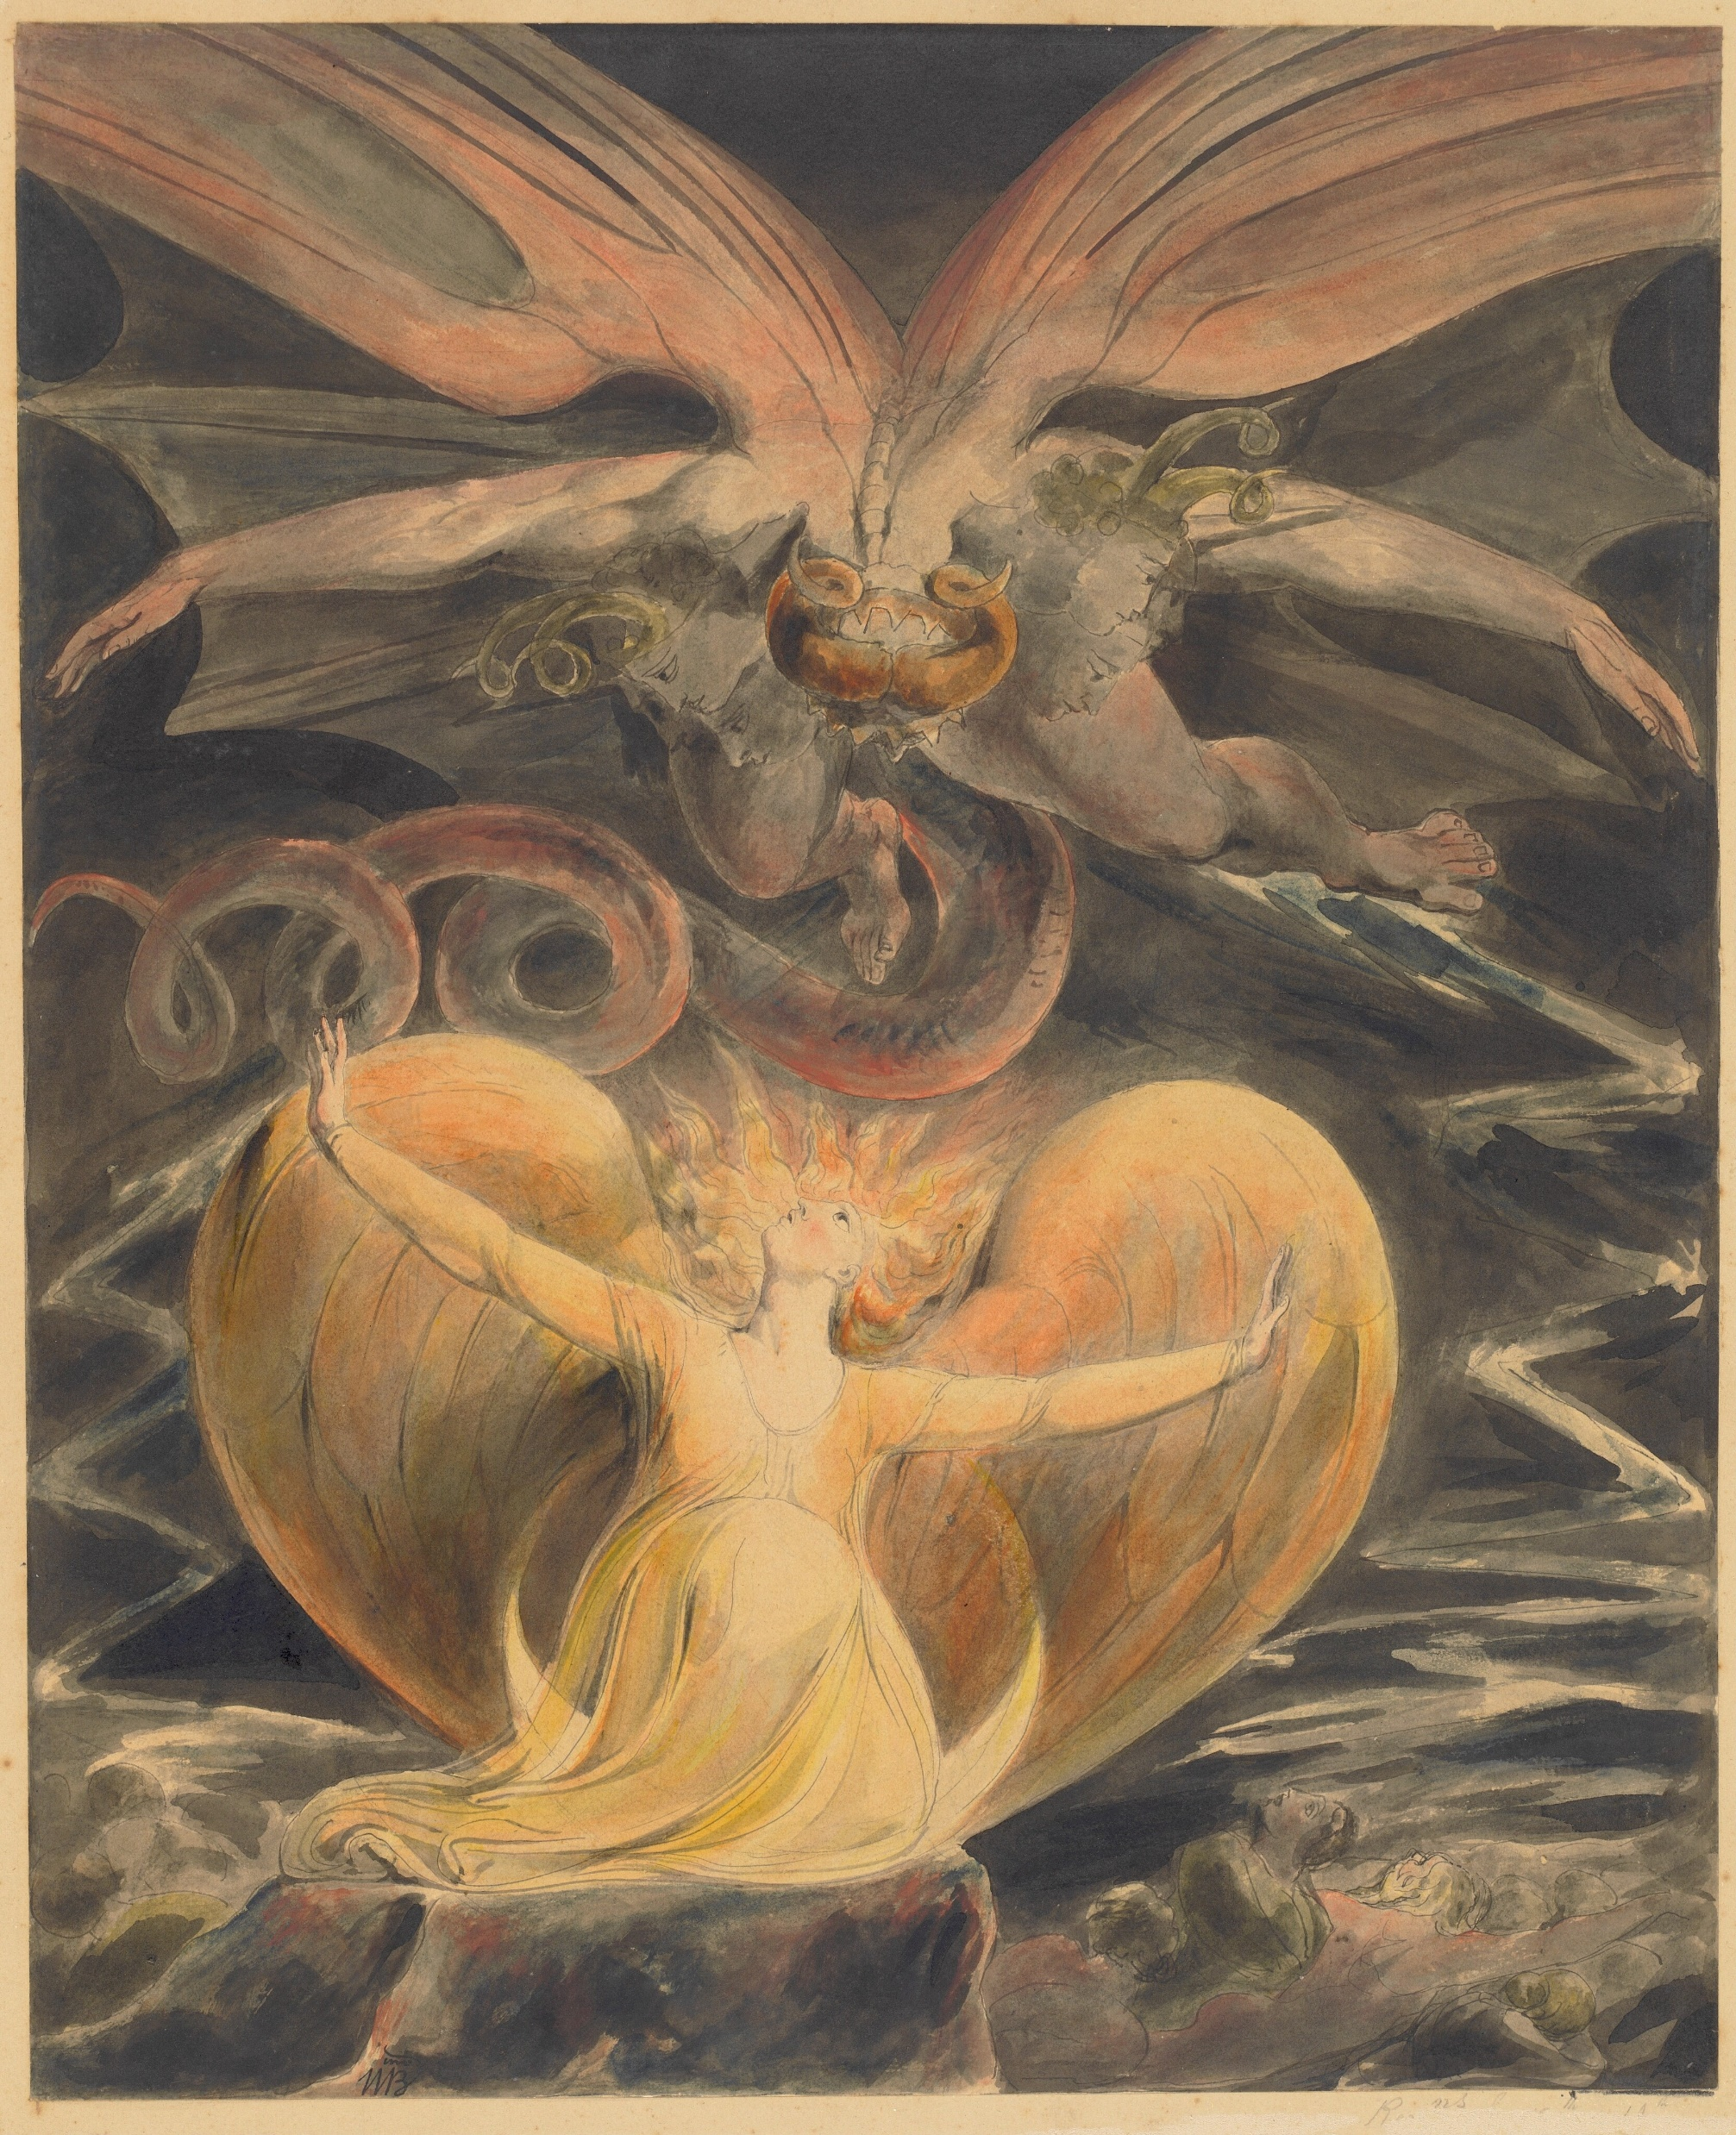
The Great Red Dragon and the Woman Clothed in Sun
William Blake
1805

Slide 8
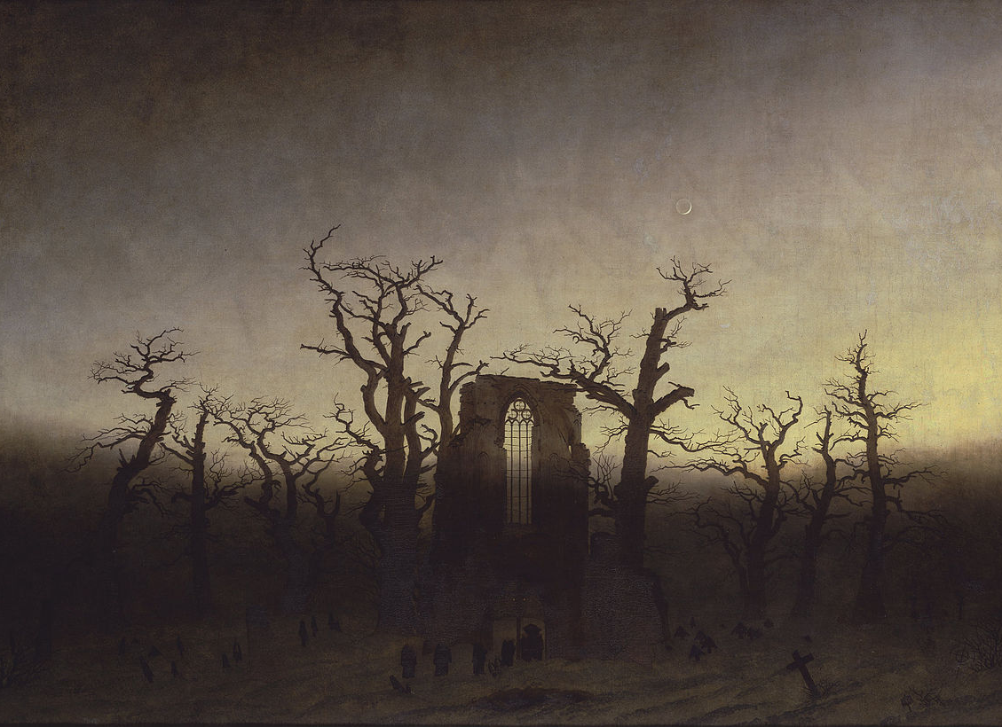
The Abbey in the Oakwood
Casper David Friedrich
1809

Slide 9
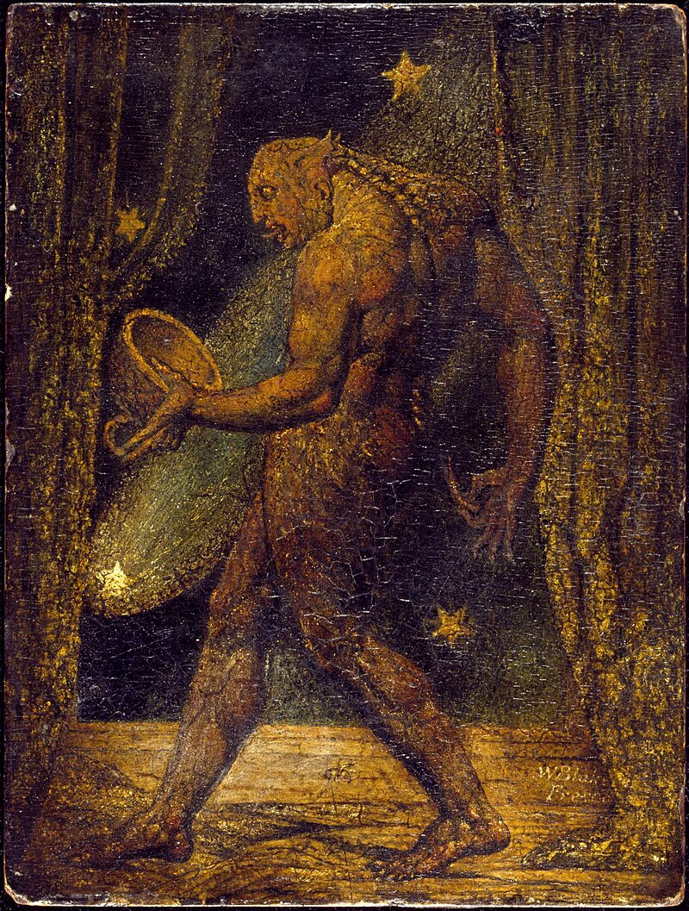
The Ghost of a Flea
William Blake
1819

Slide 10
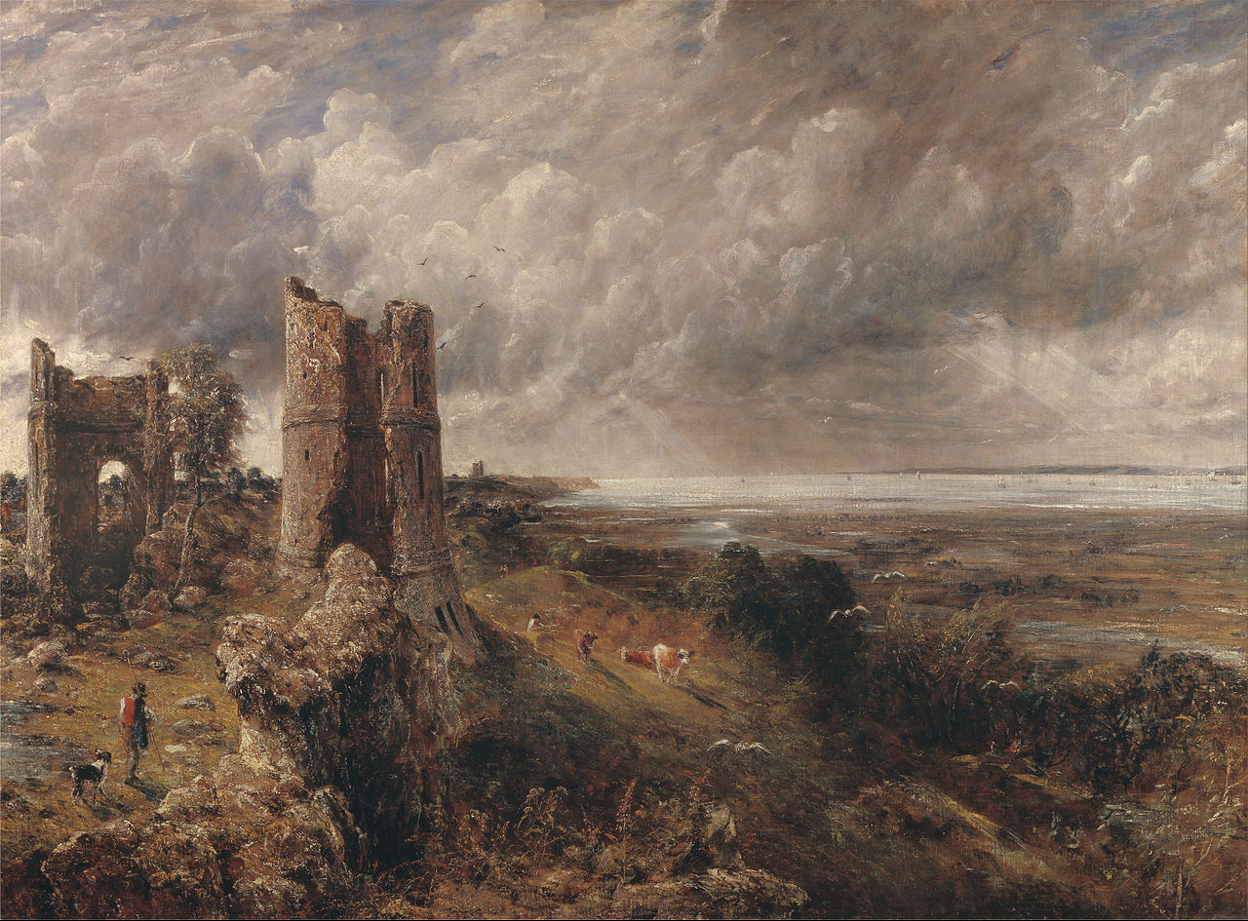
Hadleigh Castle
John Constable
1829

Slide 11
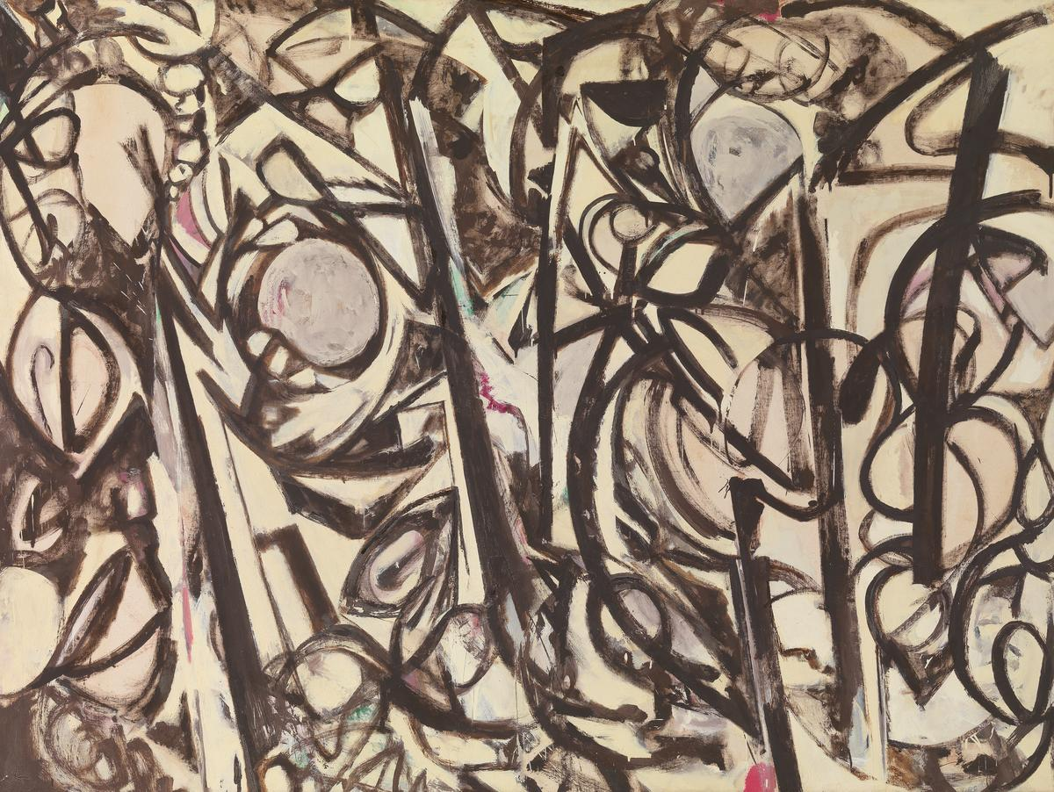
Gothic Landscape
Lee Krasner
1961

