Slide 1
Mixed Starters on Macbeth

Slide 2
Write Down What You Know
Weather | Witches | Loyalty
Theatre | James I | Violence

Slide 3
Recap
Who was James I betrothed to and what happened to her?
What book did James I publish in 1597 and what was it about?
In which year was the Witchcraft Act passed and what did it entail?
Within the context of witchcraft, what is a ‘familiar’?
In what ways is the stormy weather significant in A1-S1?

Slide 4
Recap
Cite a piece of evidence that shows James I feared witches
Write down two reasons why the weather is stormy in A1-S1
Retrieve two quotes that show Macbeth fought bravely in A1-S2
Explain how Duncan rewards Macbeth
Write down the three prophecies that the Witches make in A1-S3

Slide 5
Make the Corrections
Three witches plan to meet Macbeth, a warrior and Thane, after an uprising against king duncan. As the victorius Macbeth and Banquo cross a heath, the witche’s appear to them.
They adress Macbeth first as thane of glamis (his current title), then as Thane of Cawdor (the title of one of the rebels) and finally as King. They also tell banquo that his descendants shall be kings.
The witches vanish and noblemen approach Mcbeth to tell him that duncan has named him the knew Thane of Cawdor
Source: British Library

Slide 6
Make the Corrections
Macbeths tragic flaw (hamartia) is his exessive ambition.
malcolm is named the Prince of Cumberland by duncan.
Mcbeth likens him to a step he ‘must fall down, or else o’erleap.
Macbeth vow’s to hide his ‘black and deap desires.’
Lady Macbeth also apeals to the darknes – ‘come thick night’.
Macbeth conceedes Duncan has bean so ‘clear in his great office’.
After having doubts Macbeth eventualy declares he is ‘settled’.

Slide 7
Make the Corrections
Dramatic Ironey
Soliloquey
Audiance
Theater
Shakespear

Slide 8
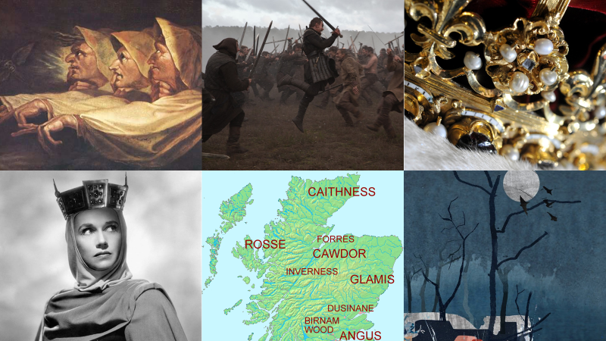
Retrieve Quotations

Slide 9
Think of Related Words
A
B
D
F
L
M
T
W

Slide 10
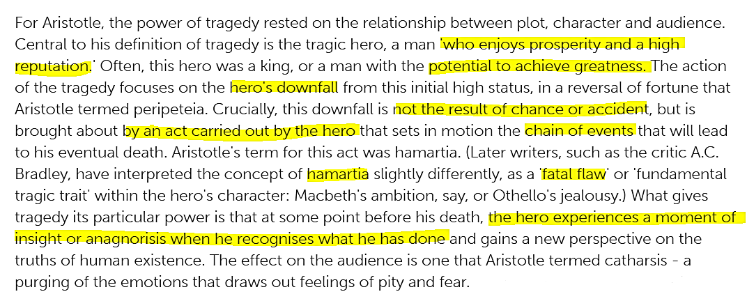
Think of Similarities
Source: EMC magazine

Slide 11
Identify Who and When
‘Methought I heard a voice cry ‘Sleep no more!’’
‘Approach the chamber, and destroy your sight’
‘Thou hast it now: king, Cawdor, Glamis, all’
‘Thou art too like the spirit of Banquo: down!’
‘Did you say all? O hell-kite! All?’
‘What, will these hands ne’er be clean?’
‘I’ll fight till from my bones my flesh be hack’d!’

Slide 12
Identify Who and When
‘As cannons overcharged with double cracks’
‘That is a step on which I must fall down, or else o’erleap’
‘That I may pour spirits in thine ear’
‘I dare do all that may become a man’
‘A little water clears us of this deed’
‘O full of scorpions is my mind, dear wife’
‘Horrible sight!’

Slide 13
Find the Evidence
Macbeth regrets killing Duncan
Lady Macbeth calls Macbeth a coward
Macbeth stops confiding in Lady Macbeth
Macbeth grows increasingly paranoid

Slide 14
Find the Evidence
Macbeth fights bravely against two rebel armies
Macbeth has doubts about killing Duncan
Lady Macbeth reacts angrily towards Macbeth
Macbeth becomes increasingly isolated

Slide 15
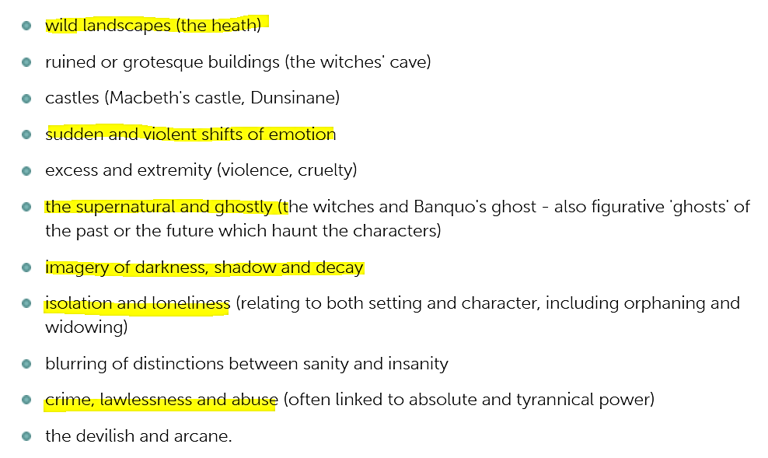
Find the Evidence

Slide 16
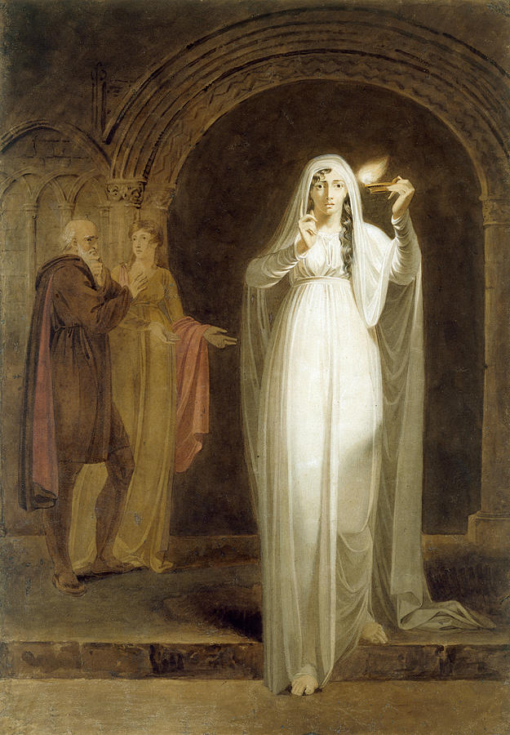
Finish the Sentences
Lady Macbeth is presented as…
This is shown by…
Act 1
Act 2
Act 3

Slide 17
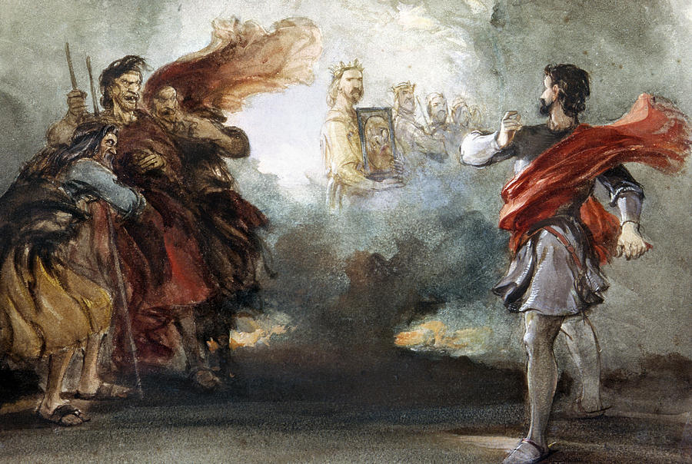
Finish the Sentences
Macbeth is presented as…
This is shown by…
Act 1
Act 2
Act 3
Act 4
Act 5

