Slide 1
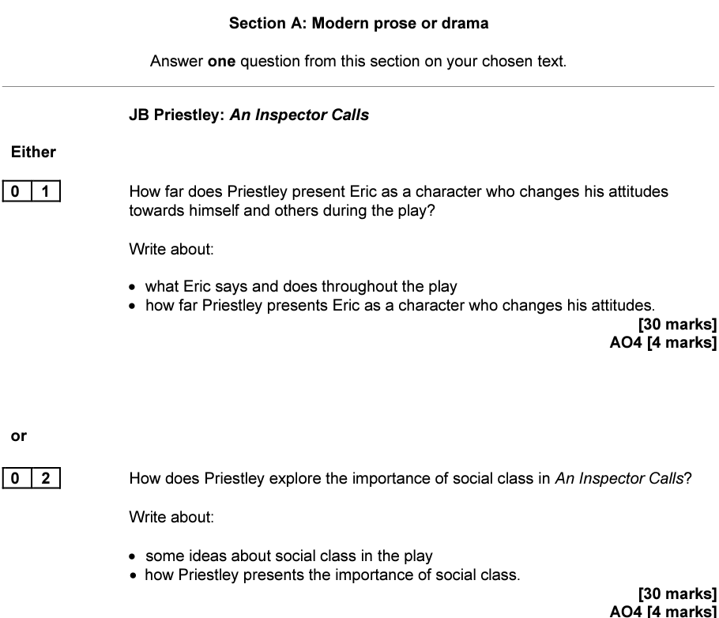
English Revision
To do this morning…
Quick recap
Zoom-in on some key extracts
Discussions and notetaking
Bring it together at the end

Slide 2
Recap
Consider the questions below:
In which year is the play set?
In which year was the play first performed in Britain?
What is Gerald’s social class?
What is Mr Birling’s social class?
Who is the only working-class character we see on stage?
What was Priestley’s central political belief?

Slide 3
Recap
Consider the questions below:
In which year is the play set? 1912
In which year was the play first performed in Britain? 1946
What is Gerald’s social class? Aristocracy
What is Mr Birling’s social class? Upper-middle
Who is the only working-class character we see on stage? Edna
What was Priestley’s central political belief? Socialism

Slide 4
Recap
Identify the speakers:
‘Arthur, you’re not supposed to say such things’
‘They’d all be broke if know them’
‘Pitiful affair’
‘I hate those hard-eyed, dough-faced women’
‘You were the wonderful fairy prince’
‘I didn’t like her manner’
‘As if a girl of that sort would ever refuse money’
‘In a way she treated me – as if I were a kid’
‘But the whole thing’s different now’

Slide 5
Recap
Identify the speakers:
‘Arthur, you’re not supposed to say such things’ Mrs Birling
‘They’d all be broke if know them’ Gerald
‘Pitiful affair’ Birling
‘I hate those hard-eyed, dough-faced women’ Gerald
‘You were the wonderful fairy prince’ Sheila
‘I didn’t like her manner’ Mrs Birling
‘As if a girl of that sort would ever refuse money’ Mrs Birling
‘In a way she treated me – as if I were a kid’ Eric
‘But the whole thing’s different now’ Birling

Slide 6
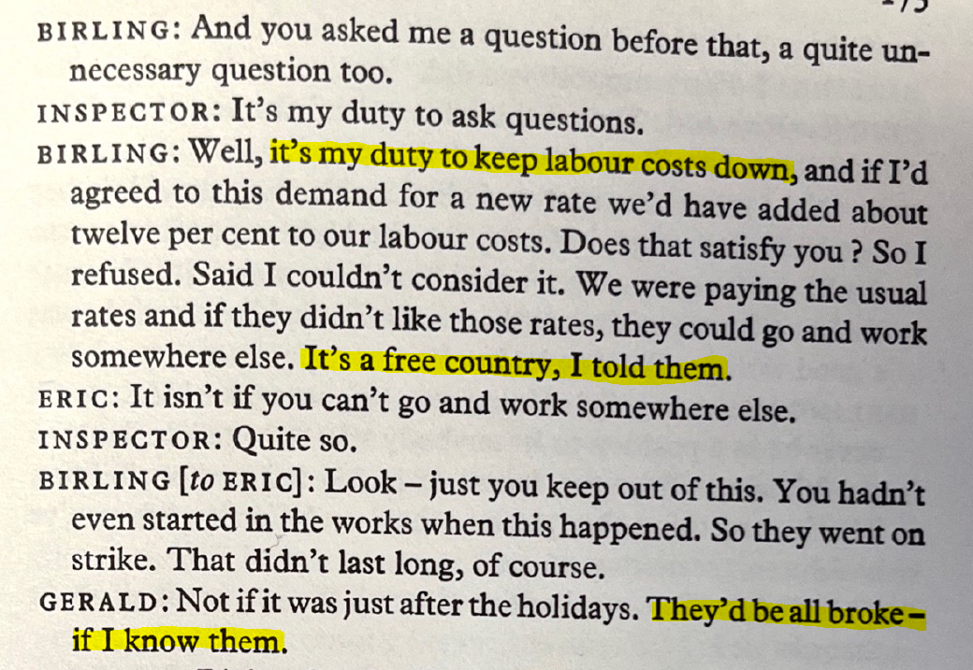
Act 1
What does the conversation between Birling and Gerald reveal about social class?

Slide 7
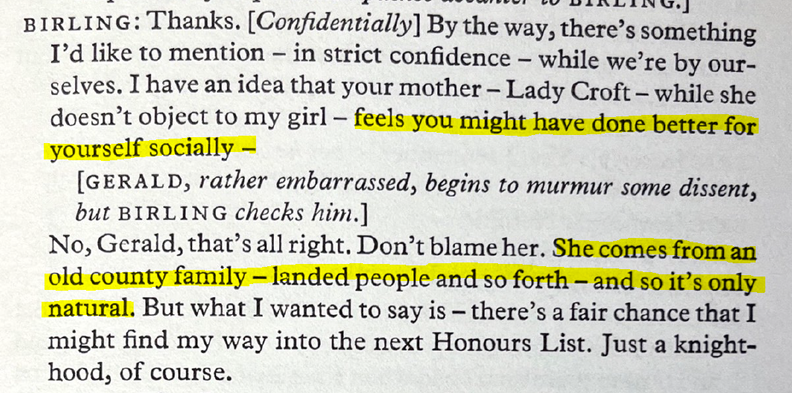
Act 1
How do the respective social statuses of Gerald and Birling differ?

Slide 8
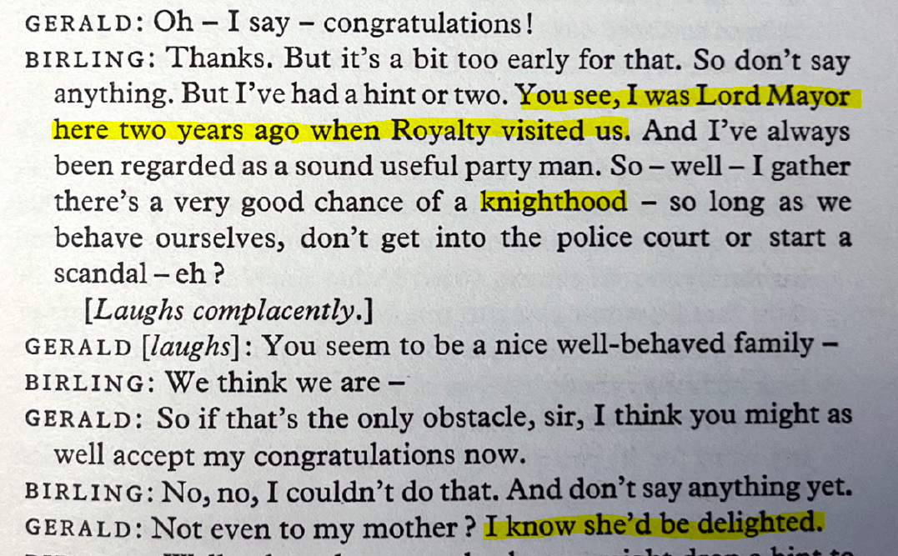
Act 1
Why is Birling so keen to signal the likelihood of receiving a knighthood?

Slide 9
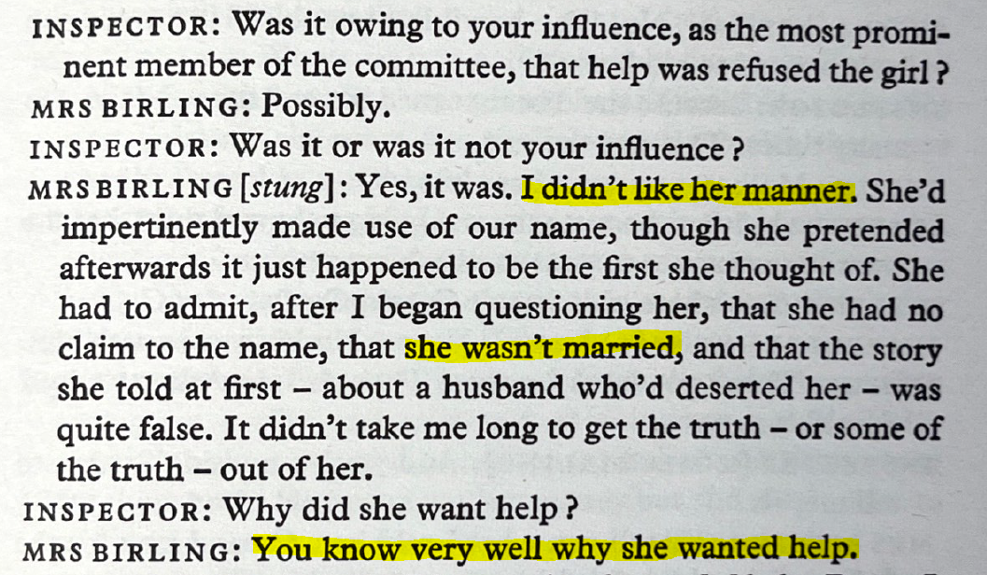
Act 2
What does Mrs Birling’s refusal to support Eva Smith reveal about the lives of working class women?

Slide 10
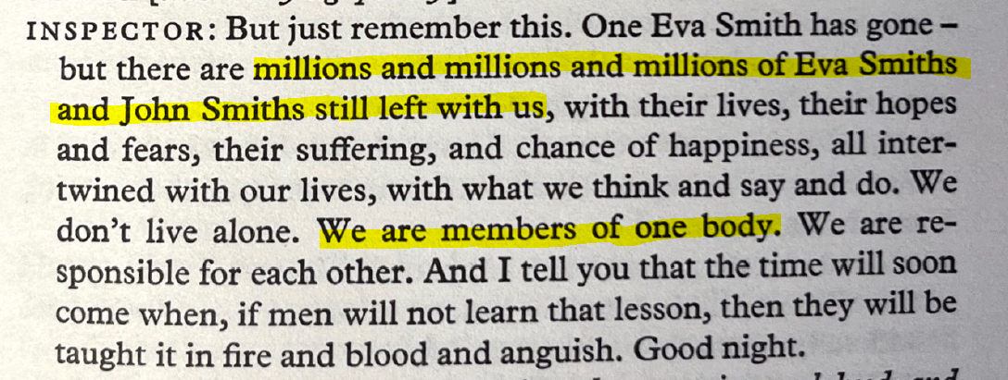
Act 3
What messages does the Inspector attempt to convey to the Birling family?

Slide 11
Other Moments
Consider what the moments below reveal about social class:
Sheila’s insistence that Eva Smith is dismissed from Milwards
The way in which Gerald (and Eric) describe the women at the Palace Bar
Birling’s attempt to excuse Gerald’s affair on the basis that ‘other young men’ behave similarly
Mrs Birling’s disbelief that Eva Smith would ‘ever refuse money’
Eric’s casual dismissal of Eva Smith as ‘pretty’ and a ‘good sport’

Slide 12
Key Points
The events on stage are constructed to…
Remind the audience of the rigidity of the Edwardian class system
Remind the audience of the inequality experienced by ‘millions’ of people in 1912
Warn the audience about the consequences of selfishness
Show that concept of ‘community’ is not ‘nonsense’
Urge the audience to continue campaigning for a fairer and more supportive society

