Slide 1
War of the Worlds

Slide 2
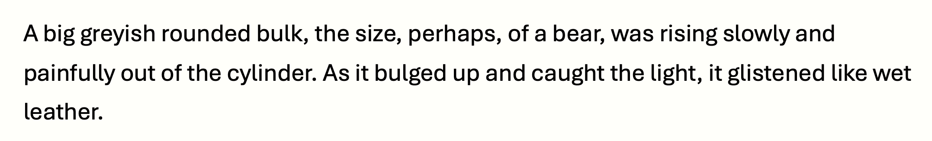
Do Now
Read the passage below and compete the tasks
Choose a synonym for the word ‘big’
Retrieve a short phrase that shows the creature does not move easily
Retrieve a short phrase that shows it looks unappealing
Explain how you know that the creature is not human

Slide 3
Dystopian Fiction
War of the Worlds, by H. G. Wells
The extract is taken from the beginning of the novel where the focus is on a large crowd that watches in horror as an alien creature emerges from what looks like a metal cylinder. The narrator (quite sensibly) flees in terror as panic spreads.
Cavity (6) | Inarticulate (18) | Ungovernable (21) | Steadfastly (26) | Convulsively (29)
Appendage (30) | Tumultuous (34) | Gorgon (34) | Aperture (45) | Slantingly (47)
Read | Reflect | Write | Share | Review

Slide 4
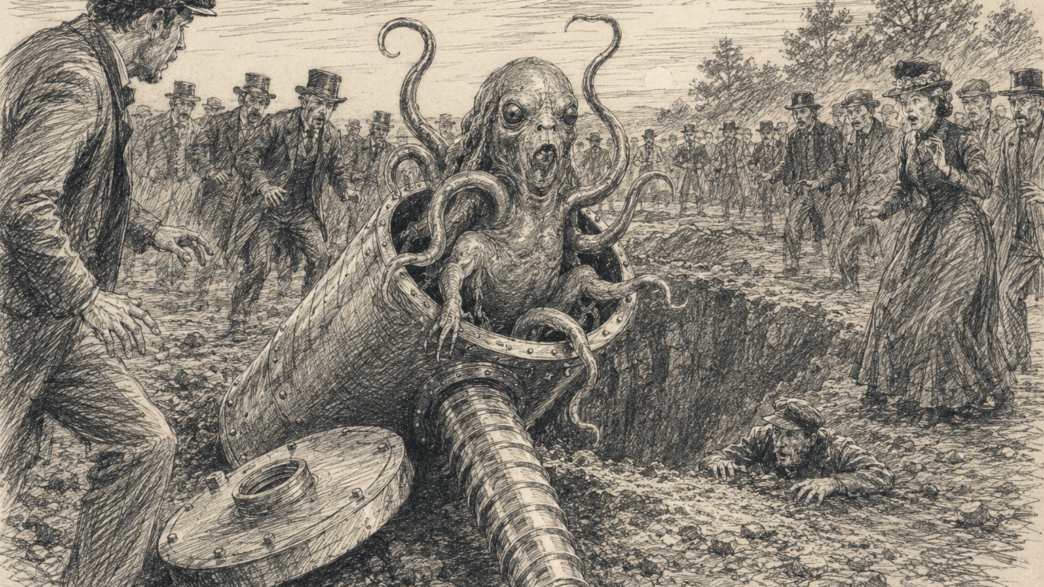

Slide 5
City of Endless Night

Slide 6
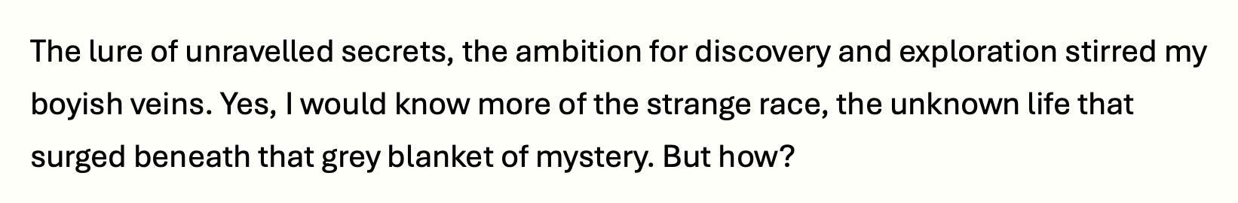
Do Now
Read the passage below and compete the tasks
Explain what you understand by the phrase ‘unravelled secrets’
Retrieve a short phrase that shows the speaker is curious
Choose a synonym for the word ‘strange’
Identify the type of question used in the final sentence

Slide 7
Dystopian Fiction
City of Endless Night, by Milo Hastings
The extract is taken from the beginning of the novel, which is set after World War I. The defeated German government, its leaders and its people have retreated into an enormous city beneath a concrete dome. All inhabitants are cut off.
Clamoured (5) | Bombardment (6) | Lull (7) | Griddle (14) | Appalling (19)
Monotonous (19) | Surged (24) | Aviators (25) | Intent (26) | Daring (27)
Read | Reflect | Write | Share | Review

Slide 8
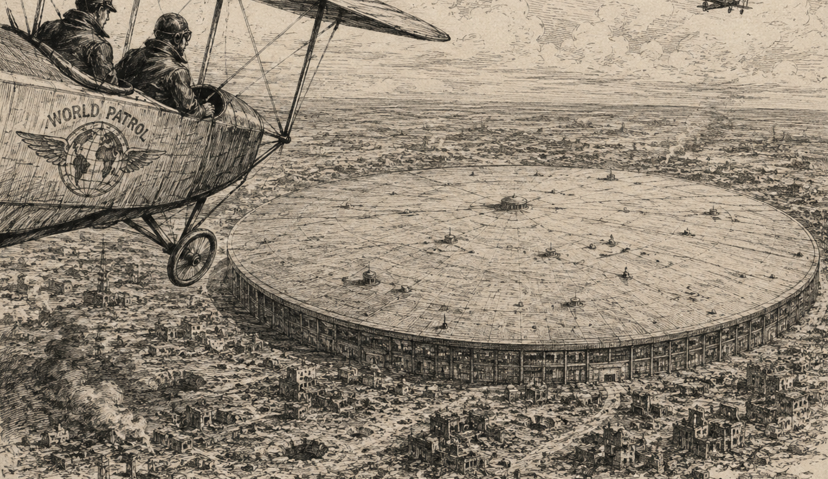

Slide 9
1984

Slide 10
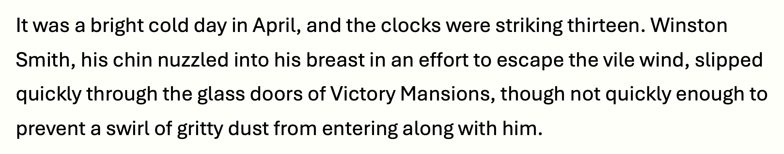
Do Now
Read the passage below and compete the tasks
Identify the detail in the first line that suggests an abnormal setting for the novel
Retrieve a short phrase from line two that shows the weather is cold
Define the word ‘mansion’
Identify the word in the passage that means the same as ‘stop’

Slide 11
Dystopian Fiction
1984, by George Orwell
The extract is taken from the beginning of the novel. Winston Smith returns to his flat in Victory Mansions, passing posters of Big Brother and the ever-present telescreen. It is clear that it’s impossible to be truly alone.
Seldom (9) | Varicose (12) | Convtived (15) | Plaque (18) | Sanguine (25)
Darted (37) | Babbling (40) | Simultaneously (42) | Conceivable (47) | Scrutinised (51)
Read | Reflect | Write | Share | Review

Slide 12
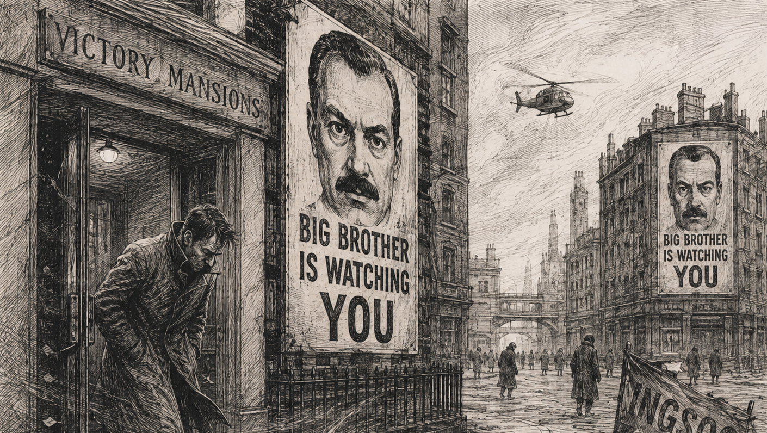

Slide 13
Brave New World

Slide 14
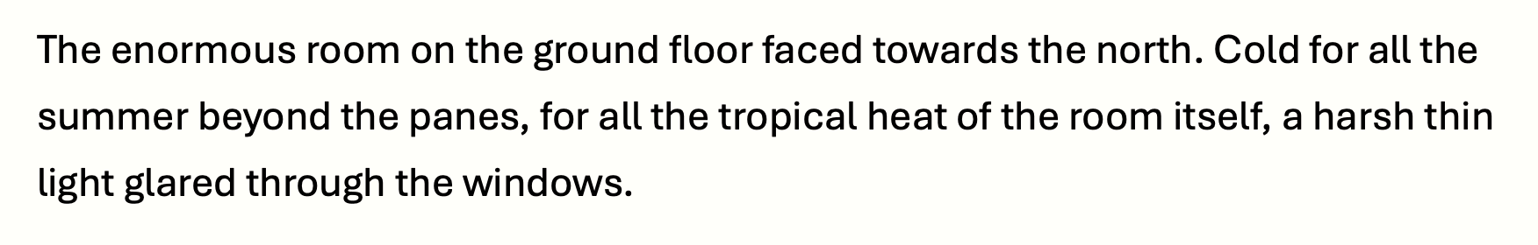
Do Now
Read the passage below and compete the tasks
Choose a synonym for the word ‘enormous’
Use the context for the passage to define the word ‘panes’
Identify a contrast in the passage
Choose a detail from the passage that makes the room seem like hostile place

Slide 15
Dystopian Fiction
Brave New World, by Aldous Huxley
The extract is taken from the beginning of the novel. A man known as the Director reveals how the World State manufactures its population as he proudly shows a group of students a series of incubators where embryos are grown.
Draped (6) | Soliloquising (17) | Callow (18) | Menacing (29) | Geniality (29)
Prominent (33) | Floridly (34) | Zealous (37) | Incubators (39) | Proliferate (45)
Read | Reflect | Write | Share | Review

Slide 16
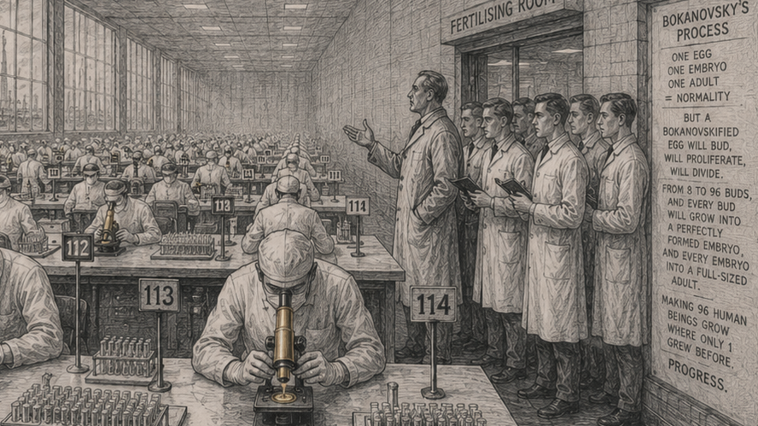

Slide 17
Fahrenheit 451

Slide 18
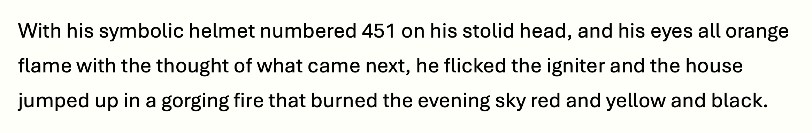
Do Now
Read the passage below and compete the tasks
Make a guess at what the word ‘stolid’ means
Explain why the character’s eyes appear to be orange
Identify the word in line two that means the same as ‘starter’ or ‘switch’
Choose detail from the line three that shows the fire is powerful

Slide 19
Dystopian Fiction
Fahrenheit 451, by Ray Bradbury
The extract is taken from the beginning of the novel. Fireman Montag takes great pleasure in watching flames consume a house. Afterwards, he calmly walks home through the sleeping city.
Kerosene (3) | Symphonies (4) | Gorging (9) | Swarm (10) | Furnace (11)
Luxuriously (19) | Grasping (22) | Halt (22) | Flue (25) | Suburb (26)
Read | Reflect | Write | Share | Review

Slide 20
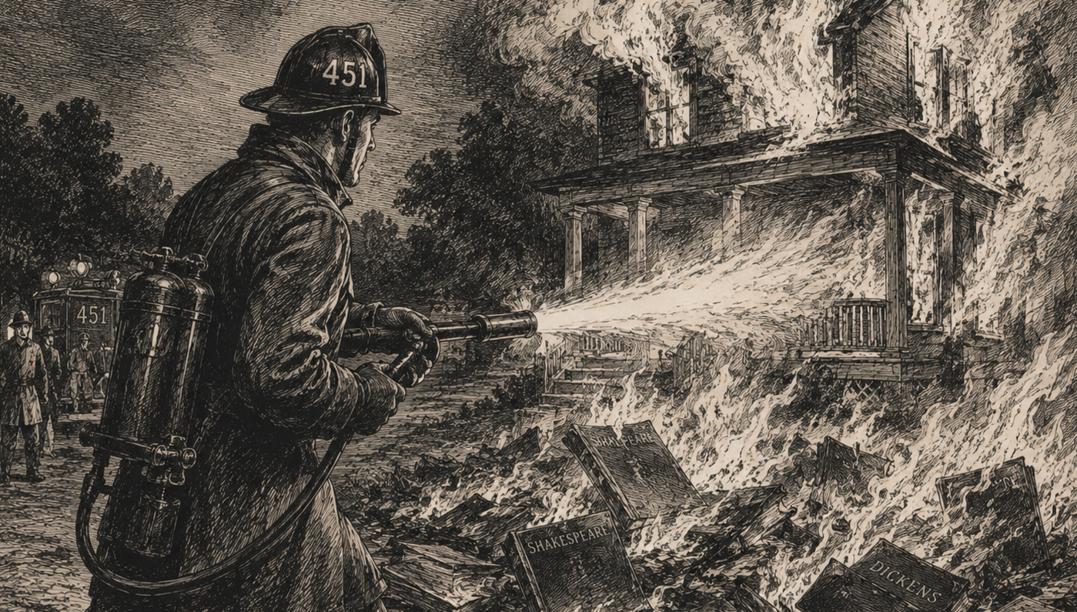

Slide 21
Lord of the Flies

Slide 22
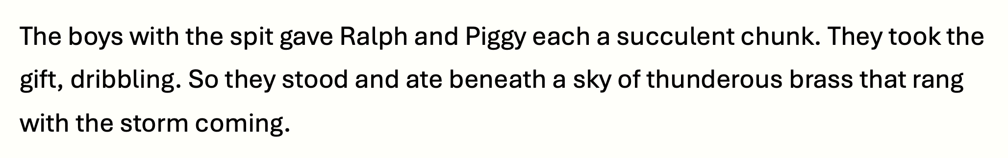
Do Now
Read the passage below and compete the tasks
Explain what the ‘chunk’ is likely to be that Ralph and Piggy are given
Provide one reason it is described as a ‘gift’
Explain what the metaphor ‘thunderous brass’ describes
Choose a detail from the passage that helps to build a sense of tension

Slide 23
Dystopian Fiction
Lord of the Flies, by William Golding
Following a plane crash, a group of boys are left stranded on a desert island without any adult supervision. They are whipped into a frenzy during a storm and mistakenly attack and kill one of their own as they repeat a bloodthirsty chant.
Reef (4) | Derision (13) | Gorging (9) | Littluns (38) | Governable (41)
Shrill (56) | Unendurable (59) | Abominable (63) | Bounded (68) | Staggered (71)
Read | Reflect | Write | Share | Review

Slide 24
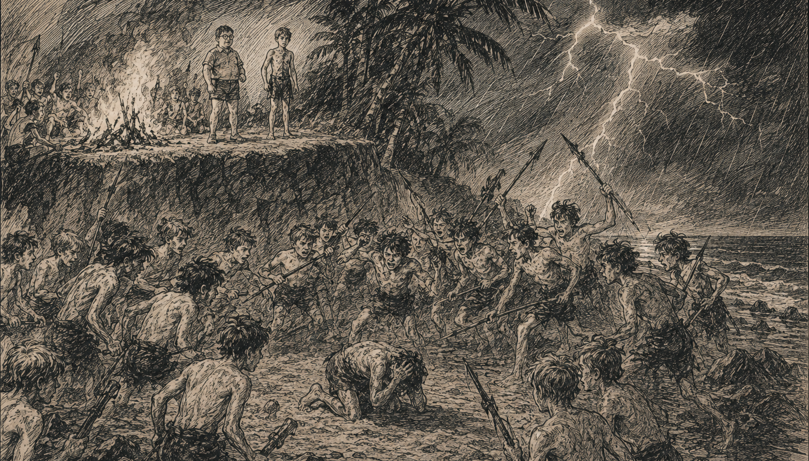

Slide 25
The Handmaid’s Tale

Slide 26
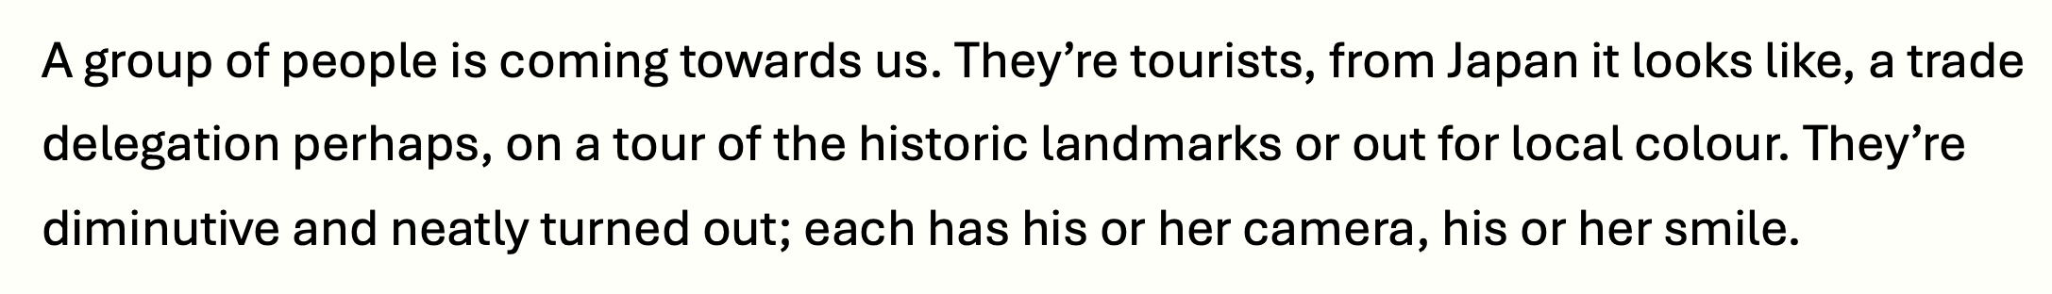
Do Now
Read the passage below and compete the tasks
Write down what you understand by the term ‘trade delegation’
Explain what the difference is between an ‘historic landmark’ and a ‘landmark’
Write down what you understand by the term ‘local colour’
Identify the word that means ‘small’

Slide 27
Dystopian Fiction
The Handmaid’s Tale, by Margaret Atwood
A totalitarian society called Gilead has replaced the United States. Fertile women are enslaved as Handmaids to bear children for the ruling class. At this point in novel, a group of Japanese tourists is fascinated by the strange sight of them.
Blatant (7) | Teeter (9) | Gorging (9) | Cavities (12) | Scrawls (12)
Repelled (15) | Twittering (19) | Bunch (22) | Sidewalk (26) | Scrap (27)
Read | Reflect | Write | Share | Review

Slide 28
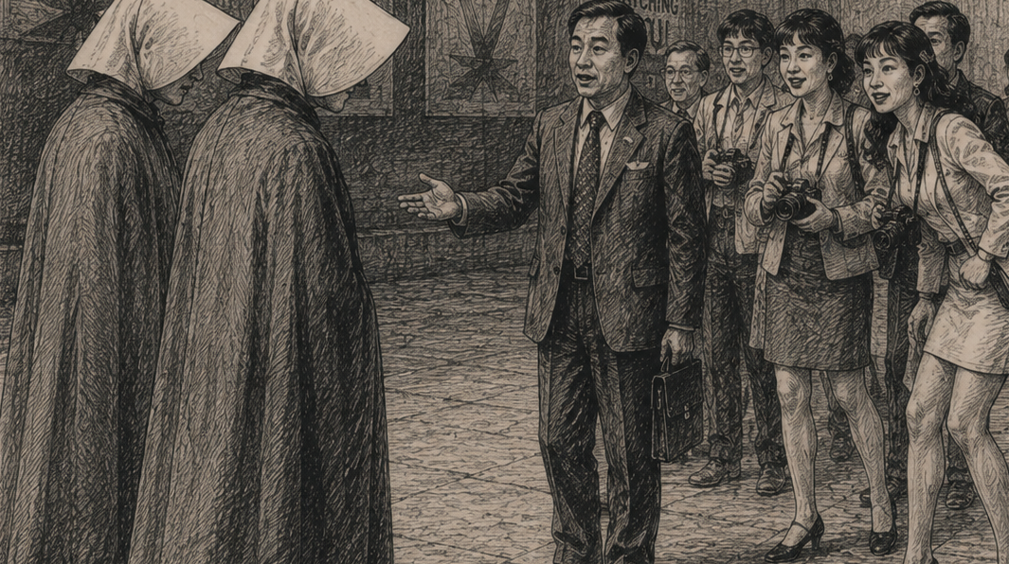

Slide 29
The Giver

Slide 30
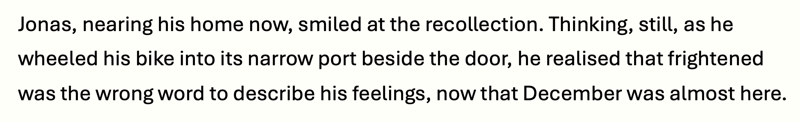
Do Now
Read the passage below and compete the tasks
Identify the word that means ‘a memory’
Explain what is means to ‘wheel’ a bike
Choose a synonym for the word ‘frightened’
Identify a detail in line three that builds a sense of tension

Slide 31
Dystopian Fiction
The Giver, by Lois Lowry
A 12-year-old boy named Jonas who lives in a strict, futuristic society that has erased pain and fear. At this point in the novel, he searches for the precise word to describe his feelings as a particularly significant day approaches.
Grim (9) | Overwhelming (11) | Scolded (12) | Patriotic (27) | Hatchery (33)
Tunic (36) | Unison (37) | Distraught (42) | Shudder (51) | Apprehensive (52)
Read | Reflect | Write | Share | Review

Slide 32
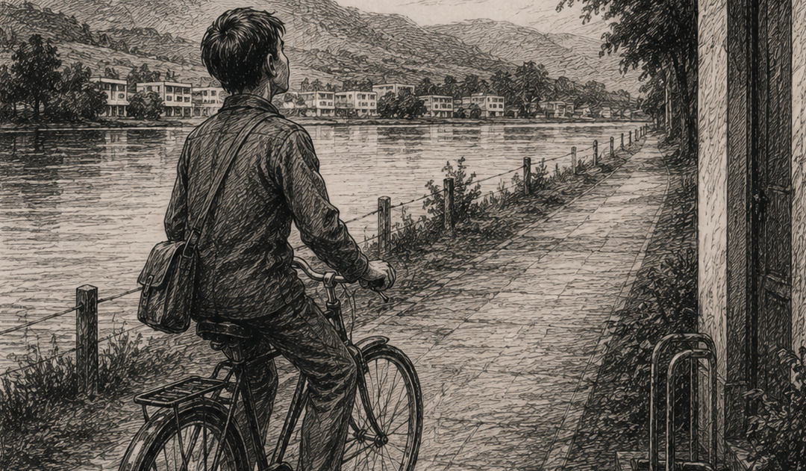

Slide 33
The Road

Slide 34
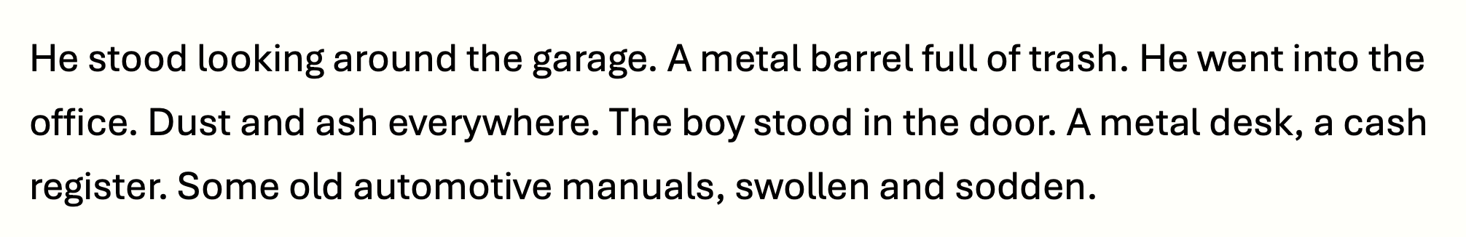
Do Now
Read the passage below and compete the tasks
Choose a synonym for the word ‘trash’
Explain how you know the garage has been abandoned for a long time
Choose a synonym for the word ‘sodden’
Use your judgement to make a guess about what the man might be looking for

Slide 35
Dystopian Fiction
The Road, by Cormac McCarthy
In a post-apocalyptic landscape, a father and son search an abandoned gas station for supplies. Everything seems to be burned and covered in ash. They salvage what they can, which is hardly anything at all.
Asphalt (4) | Ratchet (10) | Linoleum (14) | Decanting (23) | Charred (30)
Motels (34) | Gully (44) | Ledge (45) | Enshroud (54) | Apparition (55)
Read | Reflect | Write | Share | Review

Slide 36
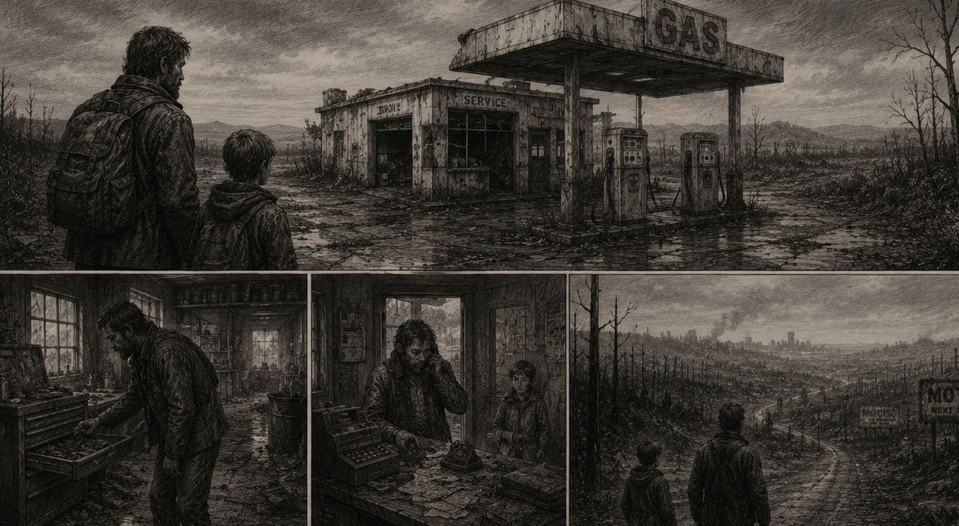

Slide 37
The Hunger Games

Slide 38
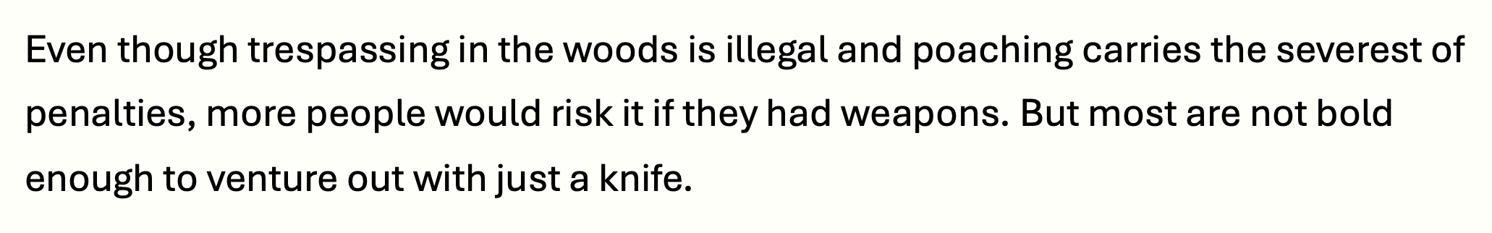
Do Now
Read the passage below and compete the tasks
Provide a definition of ‘trespassing’
Choose a synonym for the word ‘severest’
Explain why more people would go poaching if they had weapons
Explain what it means to ‘venture out’

Slide 39
Dystopian Fiction
The Hunger Games, by Suzanne Collins
The extract is taken from the beginning of the novel. A young girl, Katniss Everdeen, highlights the poverty and danger of District 12 and reveals how she has learned to hide her true thoughts from the ruling Capitol .
Deterrent (5) | Concealed (9) | Rarity (22) | Inciting (25) | Sneak (30)
Mutter (33) | Glance (33) | Blurt (35) | Indifferent (38) | Reaping (42)
Read | Reflect | Write | Share | Review

Slide 40
